Slide 1
AUTOMATIDATA PROJECT • STATISTICAL ANALYSIS
Executive Summary: Taxi Fare Evaluation by Payment Method
Inferential hypothesis testing on the average fare difference between credit card and cash payments in NYC yellow taxis.
FRAMEWORK
PRIMARY FINDING
STATISTICAL TEST
PACE Methodology
Significant Difference of +$1.22 / trip
Welch's t-test (p = 0.0000)

Slide 2



CONTEXT & SCOPE
Project Overview & Business Problem
THE PROBLEM
THE APPROACH
THE IMPACT
Business Challenge
Applied Methodology
Business Value
Determine whether there is a statistically significant difference in the average fare amount charged to customers based on their payment method.
Exploratory Data Analysis (EDA) followed by a two-sample Welch's t-test with a one-sided hypothesis direction (greater).
Support strategic decision-making to drive credit card adoption and optimize fleet dispatch for higher revenue yield.

Slide 3
STATISTICAL RESULTS
Key Findings from Welch's t-Test
CREDIT CARD
CASH PAYMENT
DIFFERENCE / LIFT
$13.43
$12.21
+$1.22
Average fare per trip
Average fare per trip
+10.0% increase per completed trip
Rejection of Null Hypothesis (H₀)
t-STATISTIC
p-VALUE
Sufficient statistical evidence proves that credit card payments generate significantly higher fares.
6.8668
< 0.0001

Slide 4

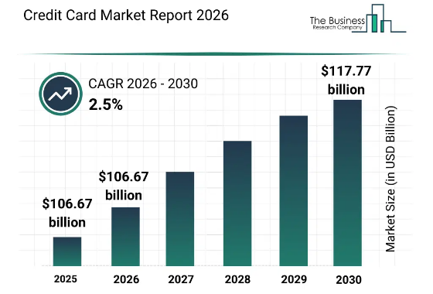
COMPARATIVE ANALYSIS
Customer Behavior Insights
Lower Digital Friction
Card usage removes the psychological barrier of physical cash, making passengers more open to taking longer or higher-fare trips.
Long-Distance Preference
Passengers traveling to airports or cross-borough destinations consistently prefer digital payment methods.
Trip Profitability
The +$1.22 fare difference easily covers payment gateway processing fees, ensuring net positive revenue growth.

Slide 5
ACTION PLAN
Strategic Recommendations & Next Steps
1
2
3
Incentivize Digital Payments
Strategic Fleet Dispatch
Multivariate Modeling
Launch in-app promotions to encourage cash users to link their primary credit or debit card.
Optimize driver coverage in business hubs and airports where card payment concentration is highest.
Build a multiple linear regression model to control for confounding variables such as trip distance and time of day.

Slide 6

Data-Driven Evidence Powering Strategic Growth
Encouraging digital payment adoption directly increases average fare value, optimizing overall platform revenue.
AUTOMATIDATA PROJECT • READY FOR GITHUB & KAGGLE PUBLICATION

Slide 7

Image Sources
https://www.thebusinessresearchcompany.com/_next/image?url=https%3A%2F%2Fd1lt5802h39cn9.cloudfront.net%2Fgraphs%2Fcredit_card_global_market_report_graphname.webp&w=1920&q=75
Source: www.thebusinessresearchcompany.com

